Slide 1
Meeting Application
Meet IGI
Shivam Goyal, Vishal, Vanshaj Tiwari, Srajan Bansal
GLA University, Mathura
Computer Science and Engineering
November 29, 2023

Slide 2
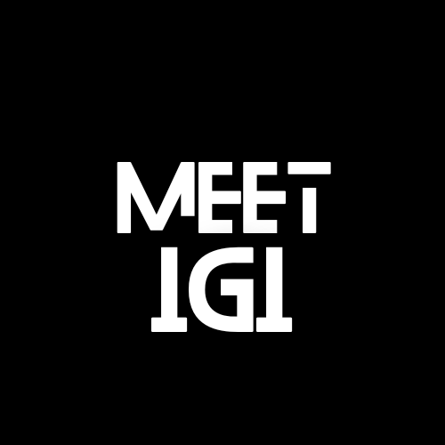
Introduction
The Meet IGI project is an innovative venture aimed at revolutionizing virtual communication and collaboration. Leveraging the power of the MERN (MongoDB, Express.js, React, Node.js) stack, Meet IGI provides a robust platform for conducting virtual meetings, fostering seamless collaboration, and enhancing overall communication experiences.
Meet IGI addresses this gap by offering a feature-rich meeting application that combines real-time communication, modular design, and agile development methodologies. The motivation behind the project is to create a user-centric solution that adapts to the evolving needs of modern professionals, providing a unified space for virtual meetings, document collaboration, and more.
Audiences can expect a comprehensive solution designed with the end-user in mind. The project's modular design allows for efficient development and maintenance, while the adoption of Agile principles ensures flexibility and continuous improvement

Slide 3
Objectives
Design and implement a comprehensive meeting application that encompasses real-time communication, collaboration tools, and a user-friendly interface. Leverage the MERN (MongoDB, Express.js, React, Node.js) stack.
Prioritize the user experience by designing an intuitive interface, incorporating modern UI/UX principles, and providing seamless communication and collaboration features.
Implement stringent security measures, including end-to-end encryption and secure authentication protocols, to safeguard user data and ensure the confidentiality of meetings.
Design the application architecture with scalability in mind, allowing for future enhancements and the integration of emerging technologies.
Aim to make a positive impact on virtual communication and collaboration by providing professionals with a versatile and reliable platform for conducting virtual meetings and collaborative work.

Slide 4
Problem Statement
The problem being addressed is the inadequacy of existing virtual communication tools to meet the dynamic and diverse needs of modern professionals. Traditional platforms often lack seamless integration, real-time collaboration features, and a user-friendly interface, leading to fragmented communication experiences.
An efficient and comprehensive virtual communication tool is crucial. The importance lies in bridging the gap left by existing solutions, providing professionals with a unified platform that facilitates real-time communication, collaboration, and an intuitive user experience.

Slide 5
Literature Review
Several virtual communication and collaboration tools exist in the same domain, such as Microsoft Teams, Zoom, and Slack. While these tools provide certain features, they may lack seamless integration, modularity, or agility in adapting to evolving user needs.
The identified gap is the need for a meeting application that combines real-time communication, modular design, and agile development methodologies. Meet IGI aims to fill this gap by offering a comprehensive solution that leverages the MERN stack, integrates agile principles, and provides a user-centric approach to virtual communication and collaboration.

Slide 6
Methodology
Algorithms:
WebSockets: Utilized for enabling real-time, bidirectional communication between clients and servers.
Techniques:
Agile Development: Adopted Agile methodologies to facilitate iterative development cycles, ensuring flexibility, responsiveness to user feedback, and continuous improvement.
Tools:
MERN Stack:
- MongoDB (Database)
- Express.js (Server-Side Framework)
- React (Frontend Library)
- Node.js (Runtime Environment)
Figma: Leveraged for designing the user interface, creating wireframes, and ensuring an intuitive and visually appealing design.
Languages:
JavaScript Python
HTML/CSS WebRTC

Slide 7
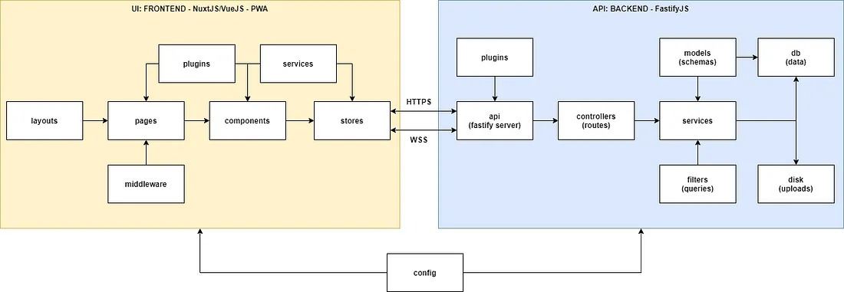
System Architecture

Slide 8
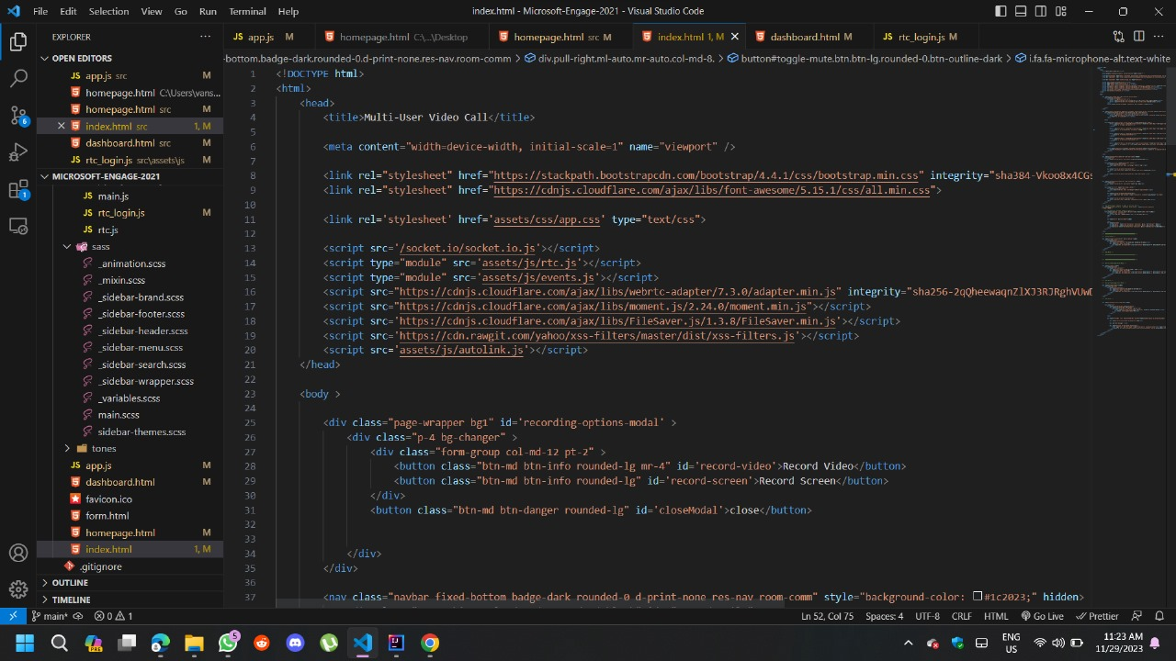
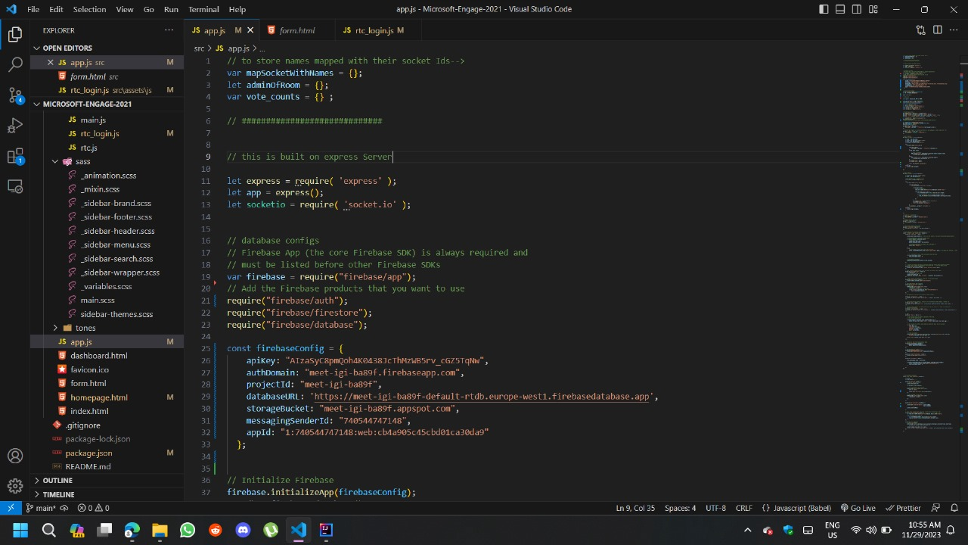
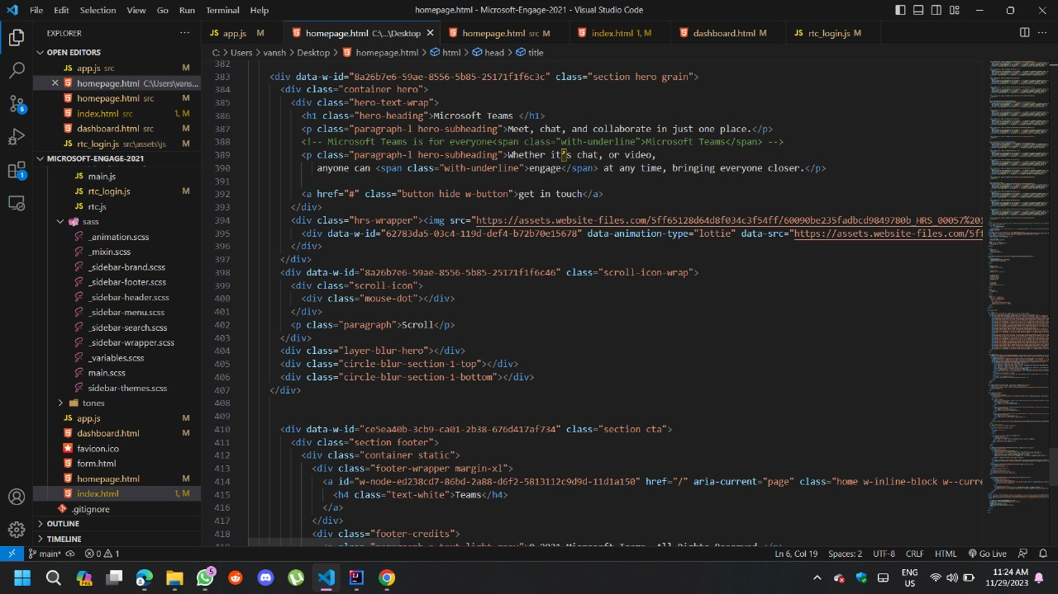
Implementation

Slide 9
Features
Real-Time Communication
Modular Design
Agile Development
Security Measures
MERN Stack Architecture
Continuous Integration
Globalization and Accessibility: Features for expanding reach globally and enhancing accessibility, making the application inclusive for a diverse user base.
Future-Readiness: Architecture designed for scalability, adaptability to emerging technologies, and future enhancements.
User-Friendly Interface: Intuitive UI/UX design using tools like SketchUp and Figma, prioritizing ease of use and enhancing the overall user experience.

Slide 10
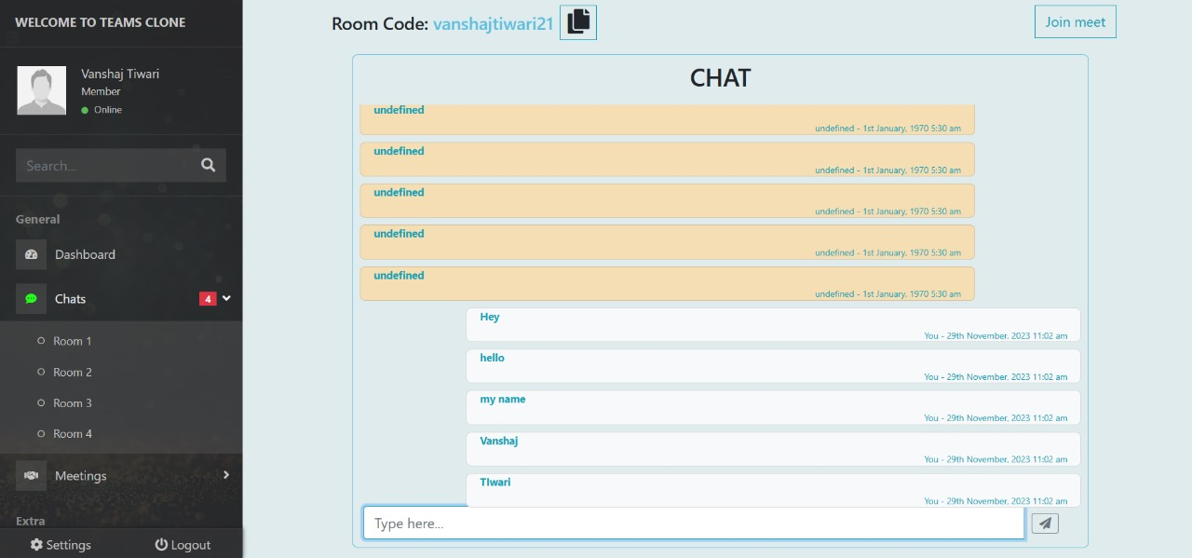
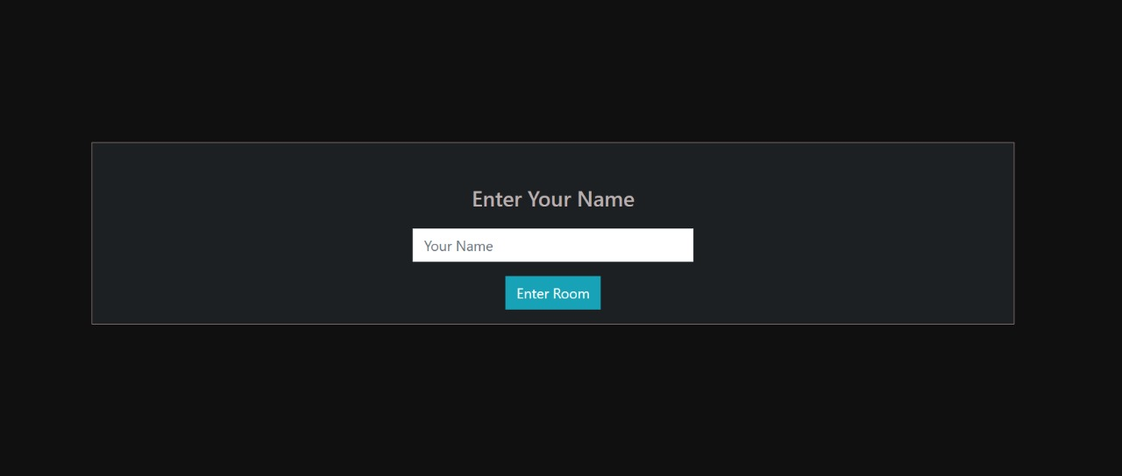
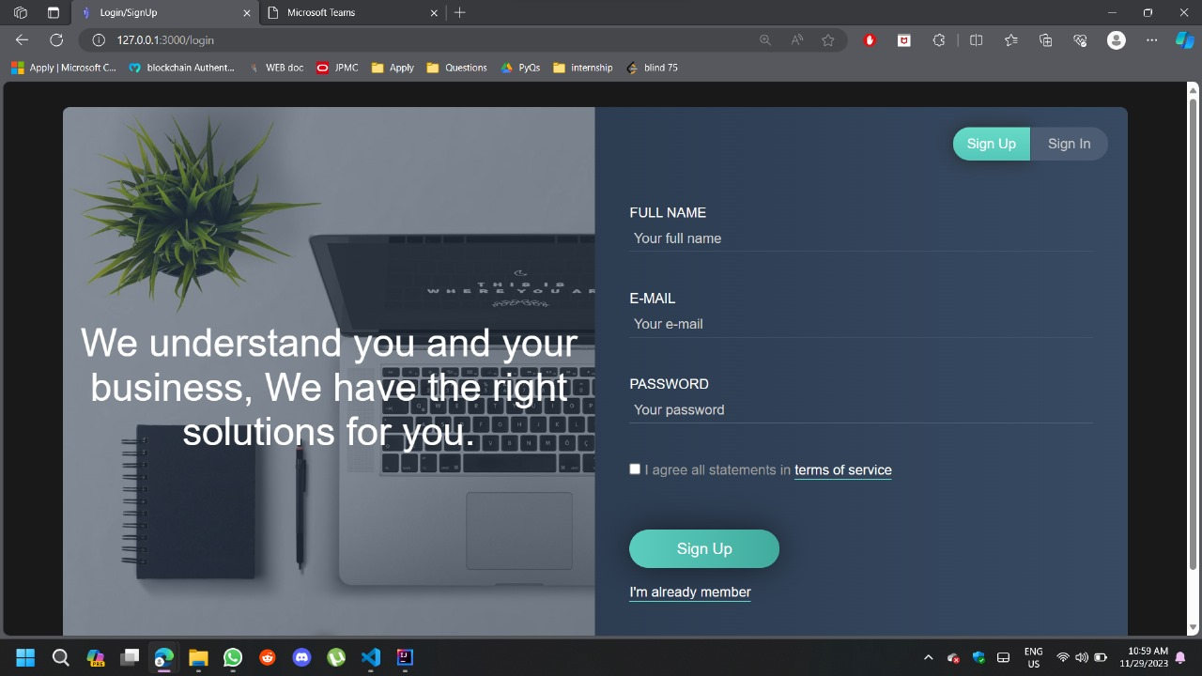
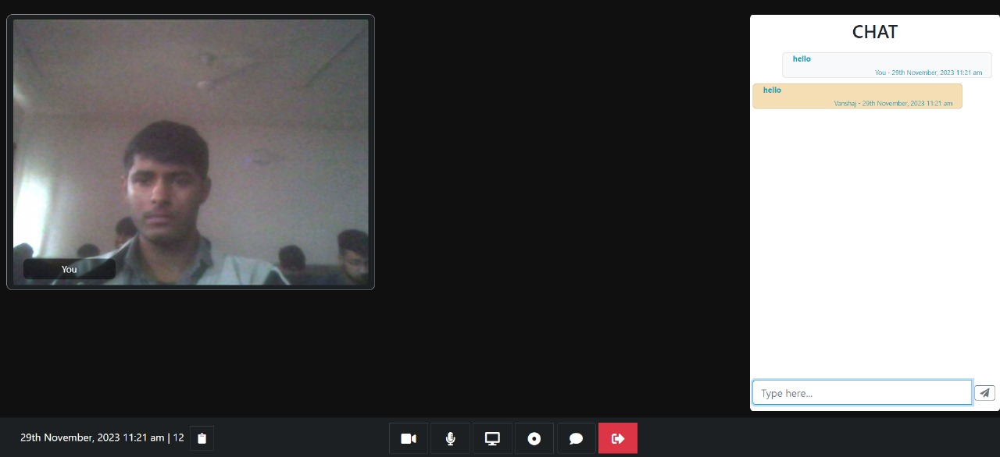
Results

Slide 11
Challenges Faced
Challenges Encountered:
Real-Time Communication Complexity
User Interface Design Iterations
Security Implementation
Agile Adaptation
Integration with WebRTC
How Challenges Were Overcome:
Frequent collaborative sessions were conducted to address real-time communication complexities.
User feedback from design iterations was actively integrated.
Security measures underwent rigorous audits and reviews, with a focus on industry best practices and consultations with security experts to ensure a robust implementation.
Team members were provided with Agile training, and project management tools were introduced to streamline Agile practices.
Thorough testing and optimization were conducted to address challenges in WebRTC integration, ensuring a reliable and consistent video conferencing experience.

Slide 12
Future Work
AI Integration for Intelligent Scheduling
Advanced Collaboration Features: like virtual whiteboards, shared code editing.
Augmented Reality (AR) Integration
Multilingual Support: allowing users to interact with the application in their preferred language.
Enhanced Security Measures
Globalization and Localization
Integration with Emerging Technologies: such as virtual reality (VR) for immersive meeting experiences.
Smart Notifications and Alerts
Scalability & Accessibility Enhancements
Blockchain Integration for Security and Authentication

Slide 13
Conclusion
Meet IGI is a comprehensive meeting application developed using the MERN stack, designed to address the limitations of existing virtual communication tools.
The project aims to develop a feature-rich application with real-time communication, modular design, and adherence to Agile development principles.
Real-time communication, modular design, user-friendly interface, stringent security measures, MERN stack architecture, and continuous integration are among the project's key features.
The system's architecture includes frontend (React), backend (Node.js with Express.js), MongoDB for the database, WebSockets for real-time communication, and tools like Jenkins for continuous integration.
Reiteration of Significance:
Meet IGI is not just a meeting application; it's a solution crafted to revolutionize how professionals communicate and collaborate in the digital age. By addressing the limitations of existing tools, embracing modern technologies, and prioritizing user experience, Meet IGI is positioned to significantly enhance the way virtual meetings are conducted, contributing to a more efficient and inclusive work environment.

Slide 14
Acknowledgments
Professors and Mentors:
- Sandeep Chhokker
External Support:
WebRTC
React
Introduction | Socket.IO
Thank you to everyone who contributed to the success of the Meet IGI project. Your guidance, collaboration, and support have been invaluable.

Slide 15
Q&A
Open the floor for questions from the audience

